Slide 1


Introduction to Office Ergonomics
Industrial Hygiene Office
Roy Deza
X6-6669

Slide 2

What is Ergonomics?
Science of fitting the workplace, furniture, tasks, tools and equipment to the worker.
Ergonomics (or human factors) is the scientific discipline concerned with the understanding of interactions among humans and other elements of a system, and the profession that applies theory, principles, data and methods to design in order to optimize human well-being and overall system performance. (International Ergonomics Association)
Notes:
White Book, USACHPPM ppt
IEA definition is too sterile, the person/worker doesn’t seem to be the important piece

Slide 3
Why do we Need Ergonomics?
Reduce occurrence of musculoskeletal disorders (MSDs), cumulative trauma disorders (CTDs) and repetitive stress injuries (RSIs)
Increase comfort and productivity
Decrease fatigue, pain and injuries
Decrease costs
  health insurance, workers compensation and lost time
Notes:
MSDs, CTDs and RSIs are basically synonyms

Slide 4
Ergonomic Injuries
Carpal tunnel syndrome
Back injuries/pain
Tendonitis
Rotator cuff injuries
Tenosynovitis (trigger finger)
Epicondylitis (tennis elbow)
Raynaud’s syndrome/disease (white finger)
Notes:
Carpal Tunnel – symptoms often burning/tingling/weakness in palm, thumb, index and middle fingers. Caused by compression of median nerve
Back injuries – caused by poor posture, improper lifting. Can prevent with strengthening core muscles, improve posture and lifting.
Rotator cuff injuries – includes shoulder muscles and ligaments. Caused by overhead work, heavy lifting.
Tendonitis – inflammation of a tendon, tendon connects muscle to bone, often caused by overuse or increase in use
Tenosynovitis – inflammation of tendon sheath
Epicondylitis – caused by repetitive lifting at elbow, movement at wrist or grasping
Raynaud’s is called a syndrome, a phenomenon and a disease. Cold and vibration are risk factors, causes pale/white extremities, cold feeling, pain. Can be a primary disease or a secondary symptom

Slide 5
IMPORTANT
Please see a medical doctor if you are experiencing any pain, discomfort or symptoms of musculoskeletal disorders or injuries
Consult a medical doctor before making changes to your workstation or beginning a stretching or exercise routine

Slide 6
Musculoskeletal Disorder Risk Factors
Repetition
Compression/Contact Stress
Force
Posture/Position
Duration
Cold
Risk Factors are Additive/Synergistic

Slide 7
Notes:
Adapted from White Book

Slide 8
How do we Prevent Injuries?
Change behaviors
  Breaks and stretching
  Improve posture
  Proper use of furniture and equipment
Change the environment
  Fit the equipment to the person
    Adjust furniture and/or equipment
    Acquire adjustable ergonomic furniture and equipment
Change the person???
  Physical fitness (strengthen and stretch)
  Weight loss (reduce forces)
Non-work Activities (computer use, sports, hobbies)

Slide 9
Ergonomic Assessments
What are current conditions
How do we achieve desired conditions
Can be performed by:
  Industrial Hygiene Office
  Individual
  Co-worker
Notes:
Each can assess the need to change equipment and behaviors

Slide 10
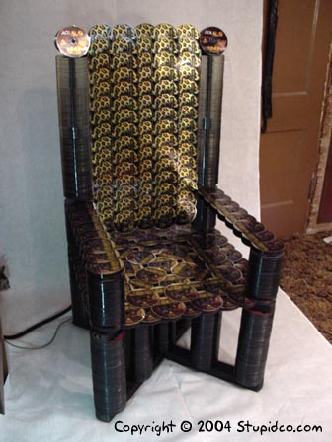
Chairs

Slide 11
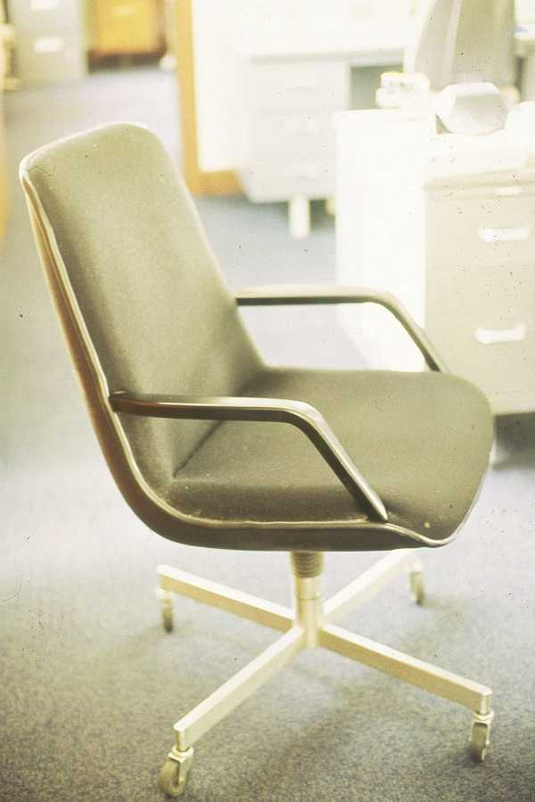
NASA Chair???
USACHPPM

Slide 12
What to Look for in a Chair
Adjustable seat pan (height, depth and tilt)
Two inches between front of seat pan and back of knees
Adjustable lumbar support
Adjustable armrests that allow you to sit with shoulders relaxed
Able to rest feet flat on floor with knees at a 90 angle
Appropriate footrest – if needed

Slide 13
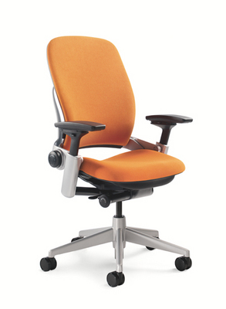
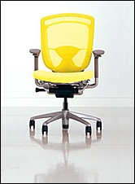
Adjustable Ergonomic Chairs
Leap Chair by Steelcase
Contessa Chair by Teknion

Slide 14
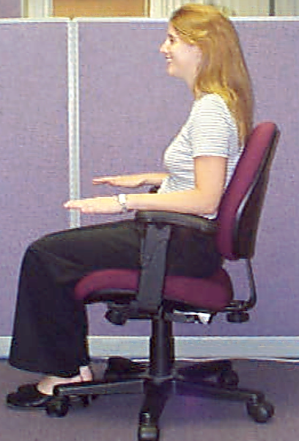
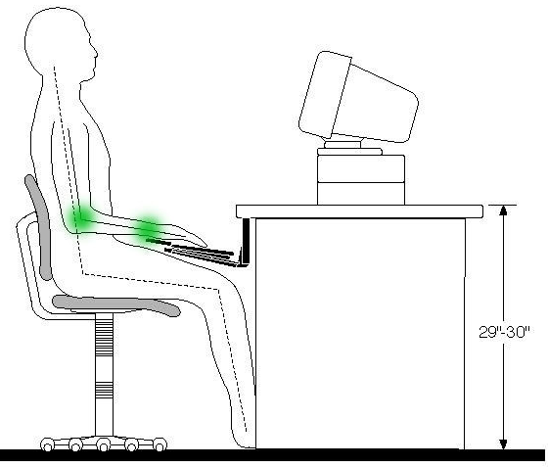
Neutral Posture
http://ergo.human.cornell.edu/
USACHPPM
Notes:
Point out all are at ~90 degrees

Slide 15
What to Look for in a Desk/Workstation
Height is appropriate for person and task (standard is ~30 inches for computer work)
Keyboard tray, preferably adjustable
Adequate work area
Frequently used items within reach
No obstructions under the desk
Notes:
Adequate work area – organized, not cramped with papers and other items piled
Frequently used items within reach
Height is appropriate for person and task (standard is ~30 inches for computer work)
Keyboard tray, preferably adjustable
No obstructions under the desk

Slide 16
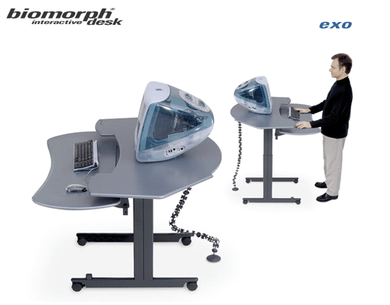
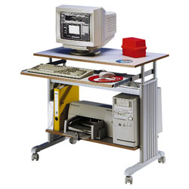
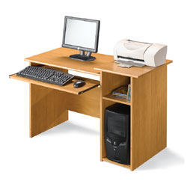

Slide 17
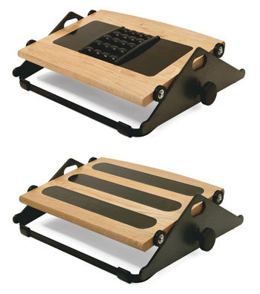
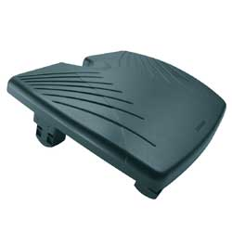
FM300B and FM100 by HumanScale
Adjustable Footrest by Office Depot
Notes:
Left – HumanScale FM300 and FM300B
Right – Office Depot

Slide 18
Computer Monitor
Directly in front of chair and keyboard
16 to 32 inches between your eyes and the monitor
The top of the screen should be approximately at eye level
Free of glare and reflections
Consider a document holder

Slide 19
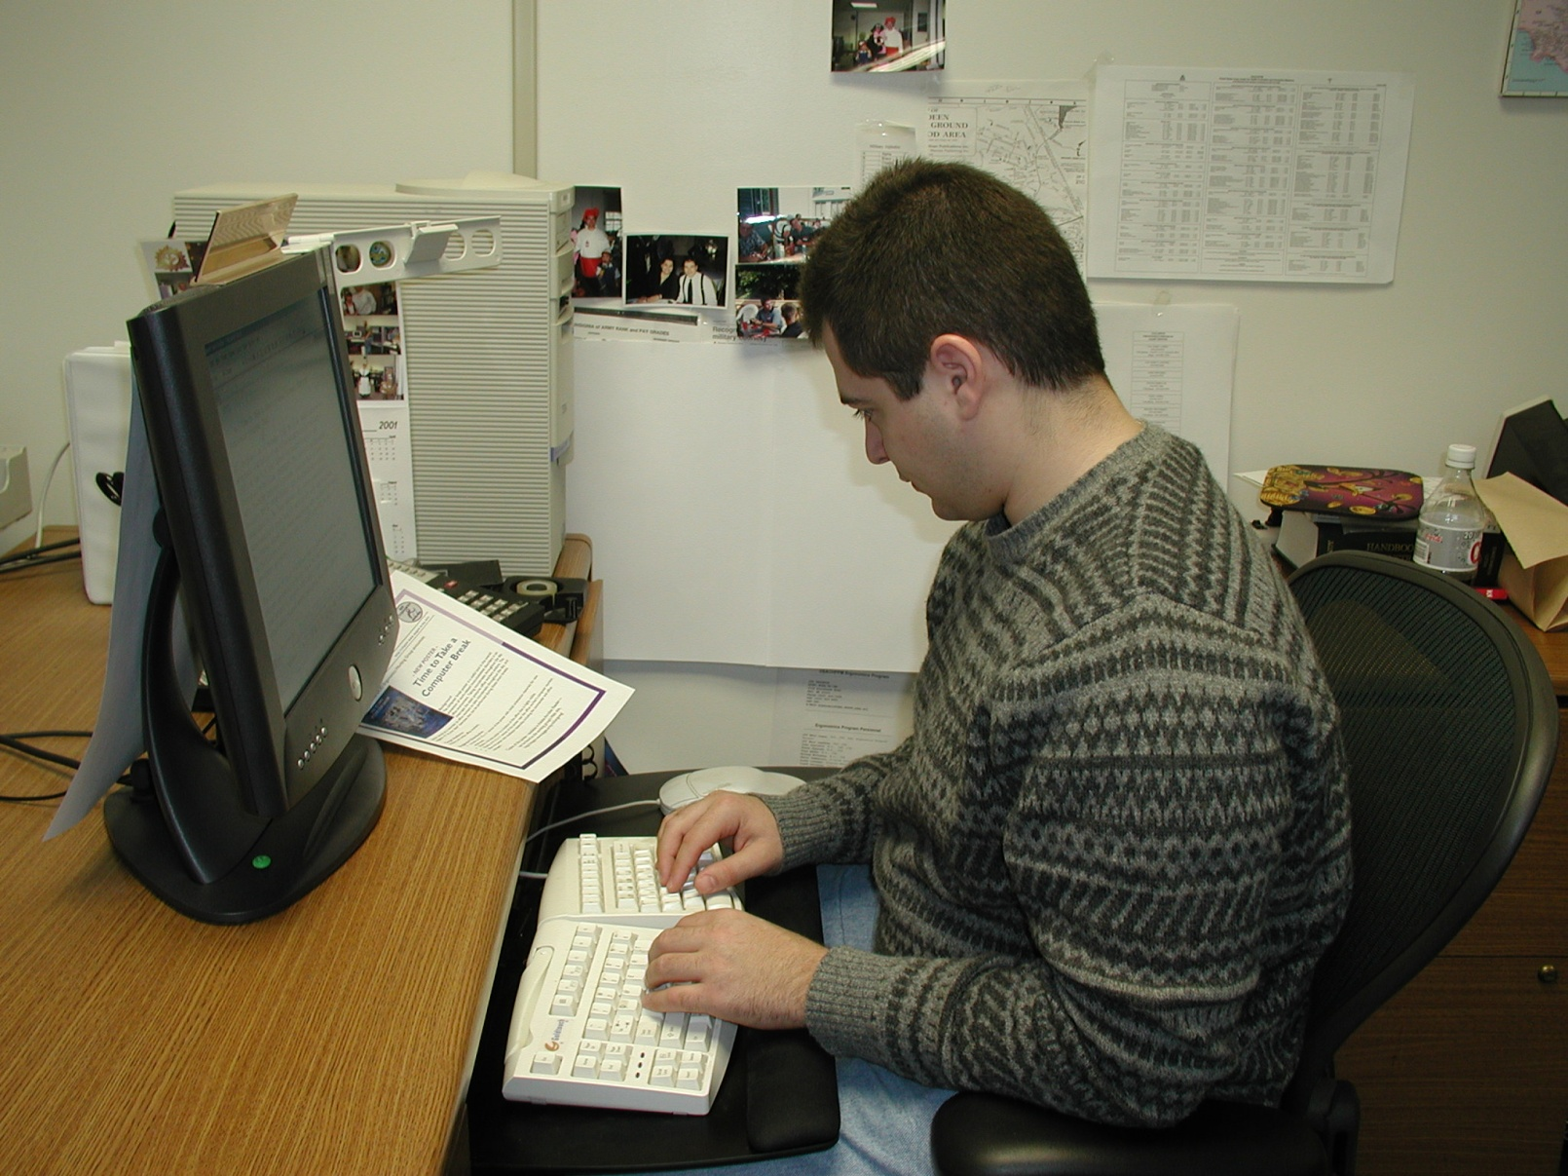
Bad
USACHPPM

Slide 20
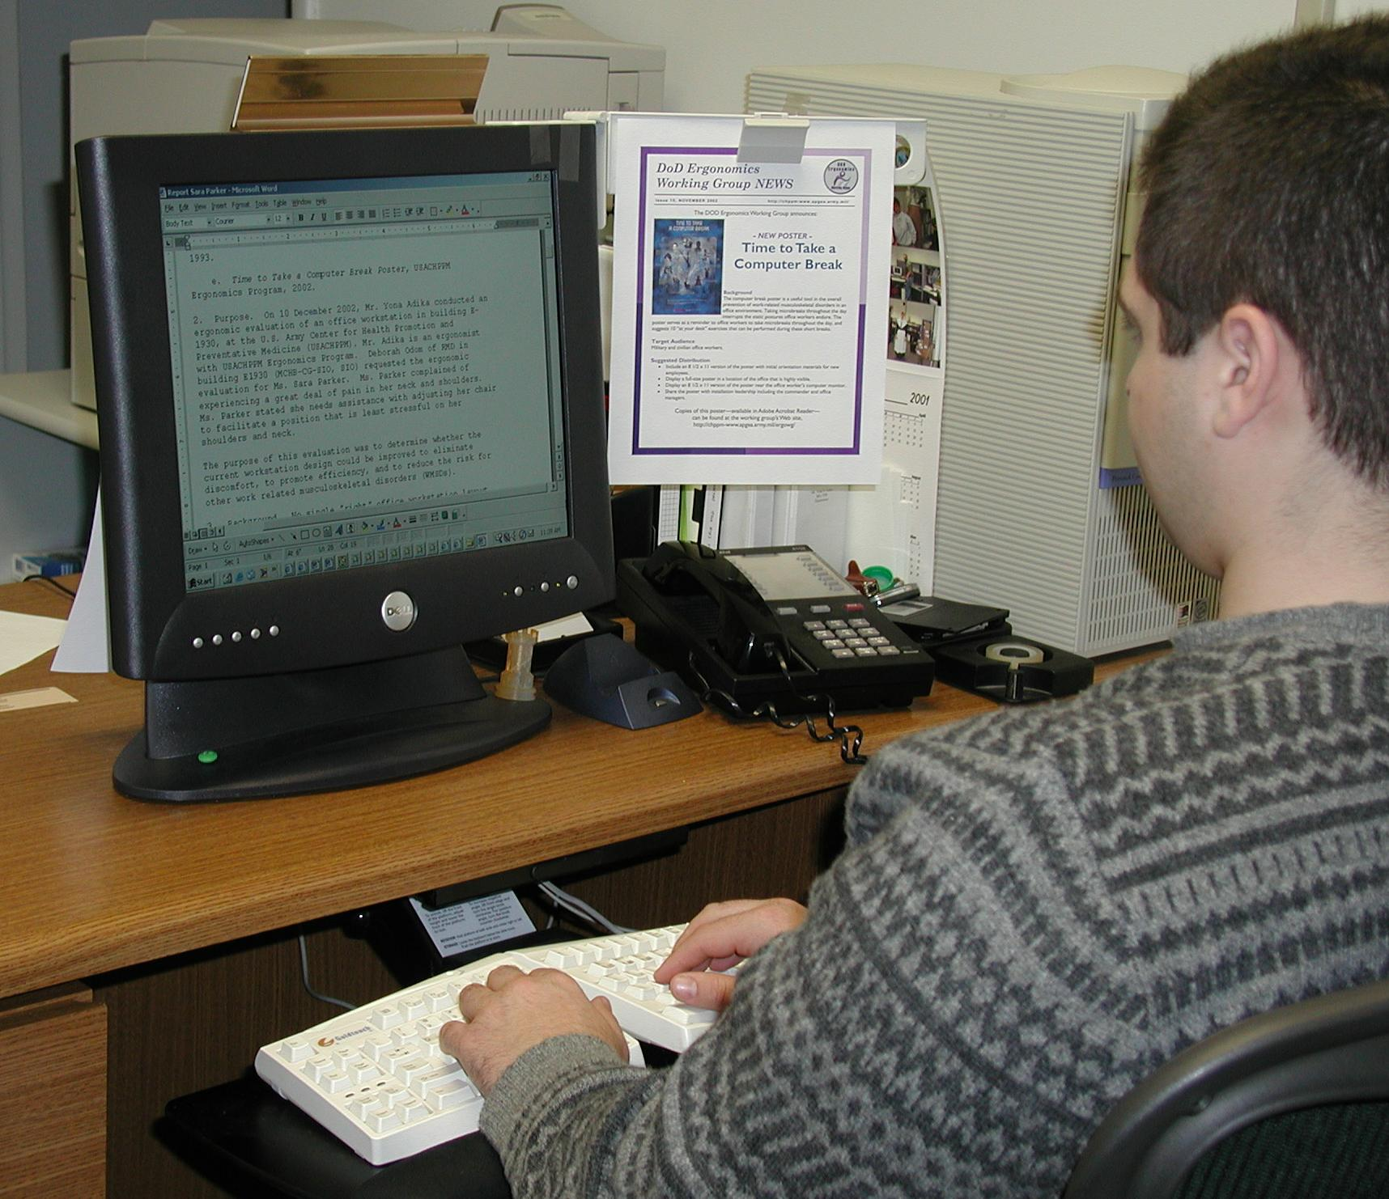
Better
USACHPPM

Slide 21
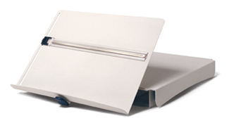
Notes:
Both HumanScale

Slide 22
Input Devices
At approximately elbow level with shoulders relaxed – adjustable tray
Keyboard and mouse/trackball on stable surface and at same height
Arms forming 100 degree angle (90 to 120 is acceptable)
Neutral position – wrists in line
Keyboard should lie flat (or angled slightly away)
Evaluate an ergonomic keyboard/mouse on a trial basis prior to purchasing (Code 224, x6-7682)
Consider wrist rests for use during short breaks

Slide 23
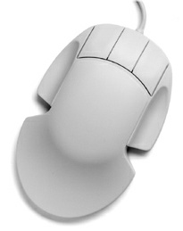
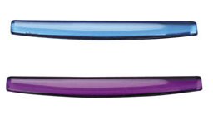
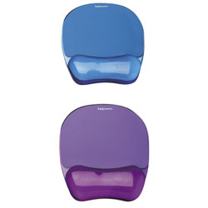
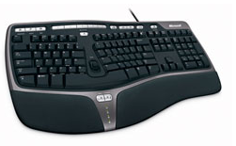
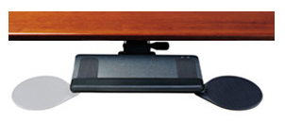

Slide 24
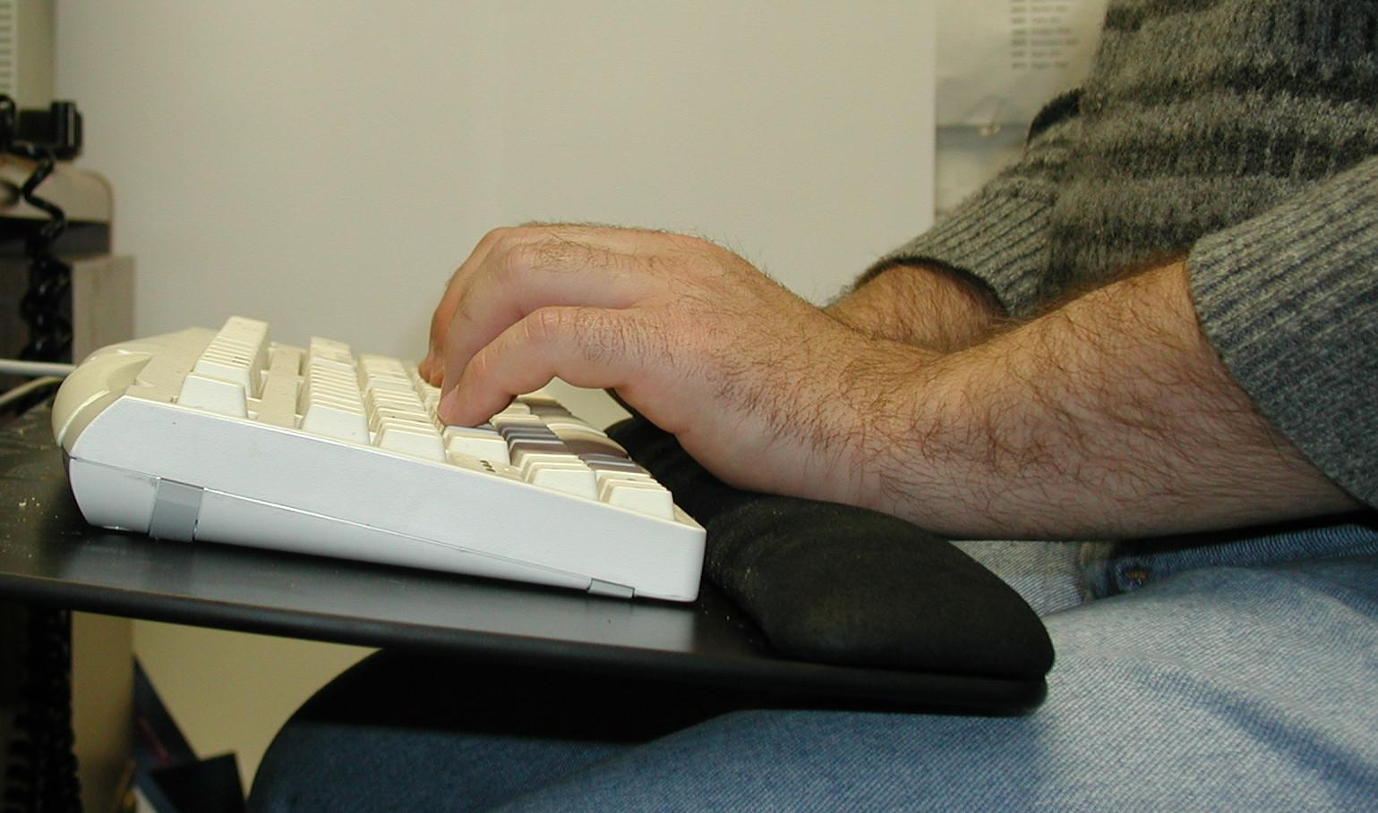
Bad
USACHPPM

Slide 25
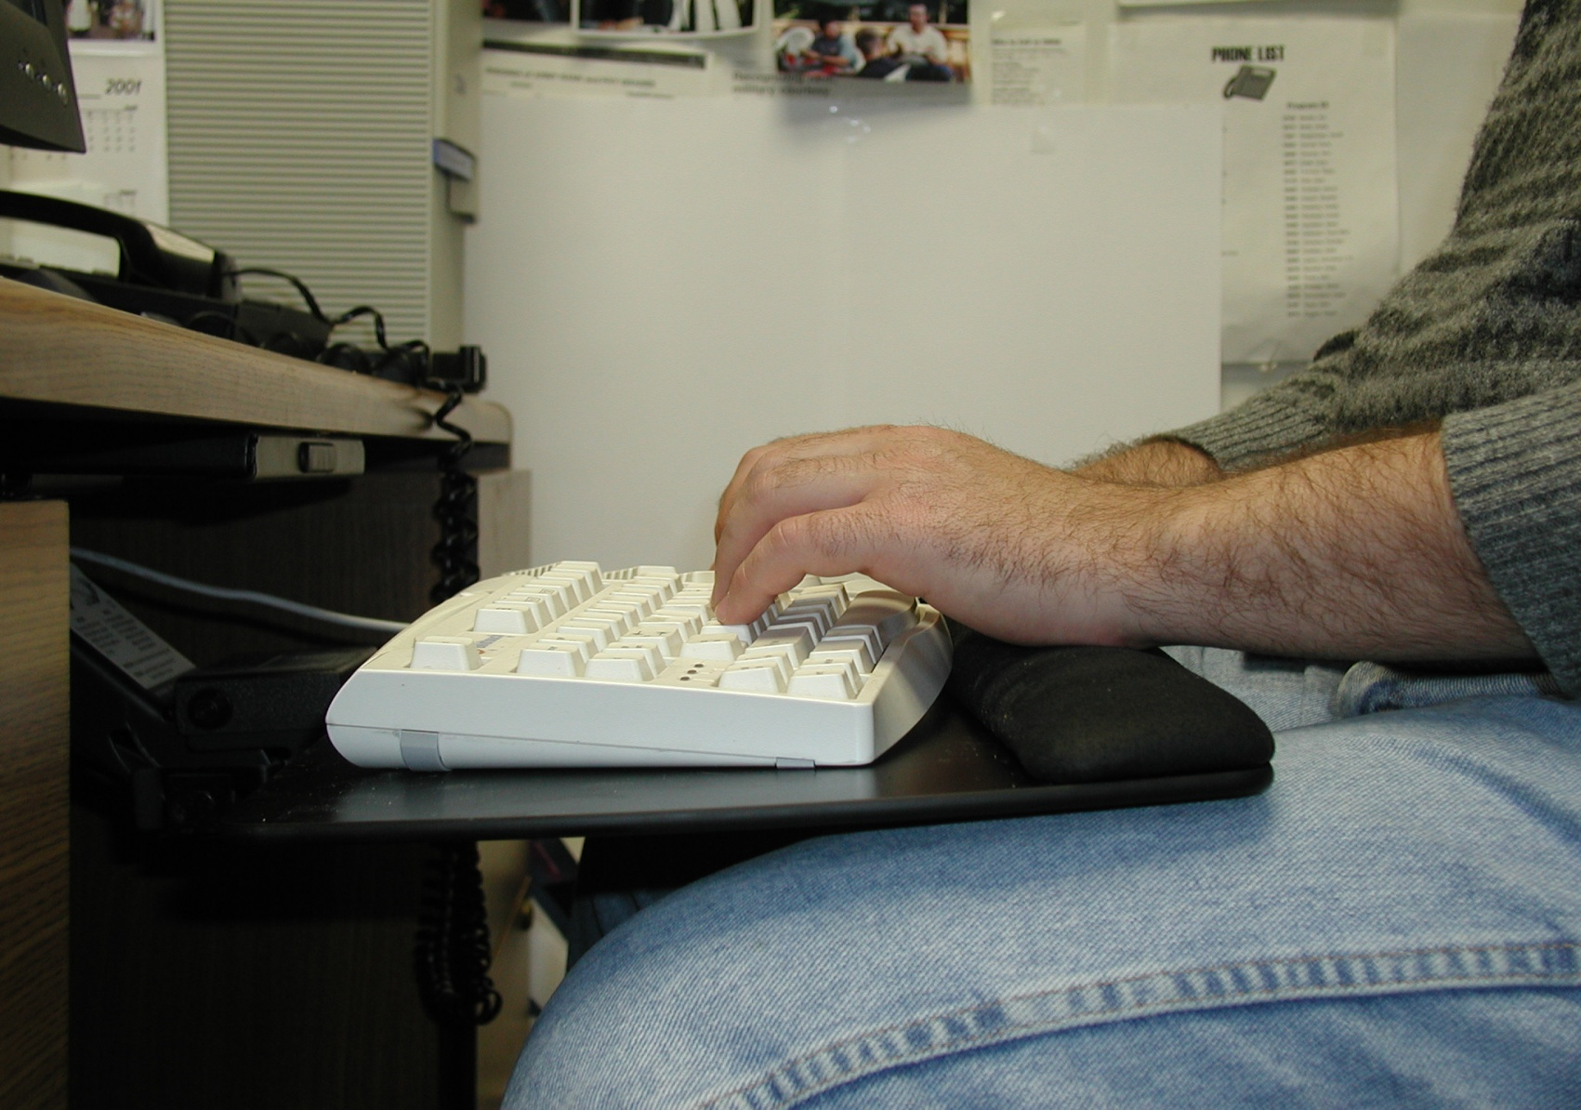
Better
USACHPPM

Slide 26
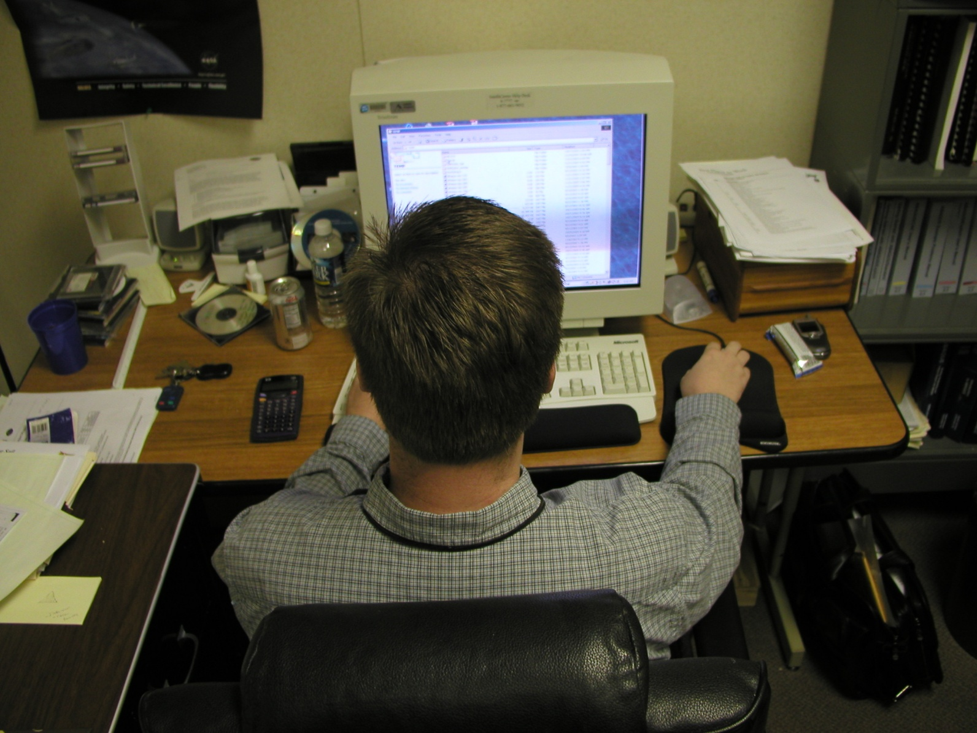
Bad
USACHPPM

Slide 27
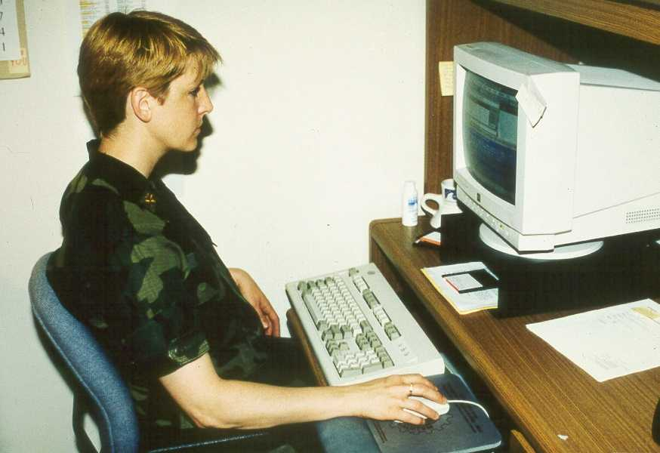
Better
USACHPPM

Slide 28
Lighting
No light sources next to or behind monitor
Pay attention to monitor position relative to window
Can use anti-glare filter

Slide 29
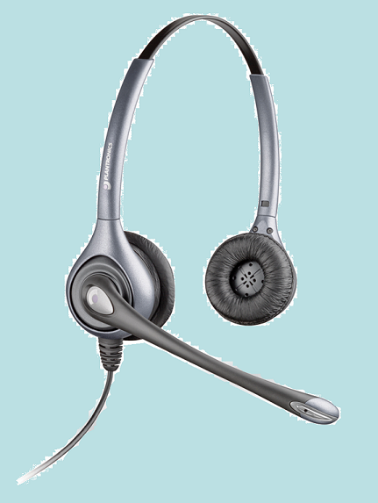
Phone
Consider a headset or shoulder rest if you spend long periods of time on the phone

Slide 30
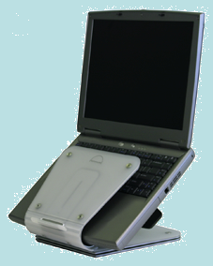
Laptops
Problems
  Monitor attached to keyboard
  Not adjustable
  Compact keyboards
  Achieving proper setup is difficult
  Similar for PDAs/BlackBerry
Solutions
  Docking station
  Independent mouse, keyboard and monitor
  Laptop holder
  Reduce use
  Desktop computer
Notes:
Docking station, keyboard and monitor are less important as today’s computers have plenty of USB connections, larger keyboards and larger monitors.

Slide 31
Administrative Controls
Minimize Stress
Training – working in neutral position
Breaks/Microbreaks – at least once per hour
  Reduce injuries, won’t decrease productivity
  Can be as short as 30 to 60 seconds
  Focus on an object 20 feet away
  Not required to stop work, can change task
Stretching – at least once per hour
Notes:
Administrative Controls - “The use of management involvement to limit an employees exposure to a work related musculoskeletal disorder risk factors and to increase the workers’ ability to endure stress.”

Slide 32
The Art of Ergonomics…
Must consider each piece of furniture and equipment and consider administrative controls in order to provide a workstation that fits the user and prevents musculoskeletal disorders.
Can require compromise if the desired fit can not be achieved for each piece of furniture or equipment.

Slide 33
IMPORTANT
Please see a medical doctor if you are experiencing any pain, discomfort or symptoms of musculoskeletal disorders or injuries
Consult a medical doctor before making changes to your workstation or beginning a stretching or exercise routine

Slide 34
Resources
Computer Workstation Ergonomics, NASA pamphlet
Cornell University Ergonomics Web. http://ergo.human.cornell.edu/
National Institute for Occupational Safety and Health: Ergonomics and Musculoskeletal Disorders. http://www.cdc.gov/niosh/topics/ergonomics/
Healthy Computing. http://www.healthycomputing.com/health/

Slide 35
at GSFC
Industrial Hygiene Office (x6-6669)
  Ergonomic assessments
  Recommend behaviors, equipment and furniture
Interior Design Group (x6-1562, x6-7682, x6-5677)
  Literature and physical furniture library
  Product selection and ordering
  Located in Building 18
  http://lmd.gsfc.nasa.gov/interior_design.html
Notes:
Interior Design Group - Literature and physical furniture library
Chairs, desks, footrests, keyboard trays are available for trial

Slide 36
THANK YOU
Contact Information:
Roy Deza
Romulo.B.Deza@nasa.gov
X6-6795

